Slide 1
Scenarios:
“I kinda think I’m interested in cancer research…”
“My mom knows this great scientist who will be my mentor…”
“I found a good journal article but I have no idea how to make contact with the author…”
“I found a great article but it was published in 1977…”
“I found a great citation – article looks really good – but I can’t find the full text anyplace and even Ms Read is stumped….”

Slide 2
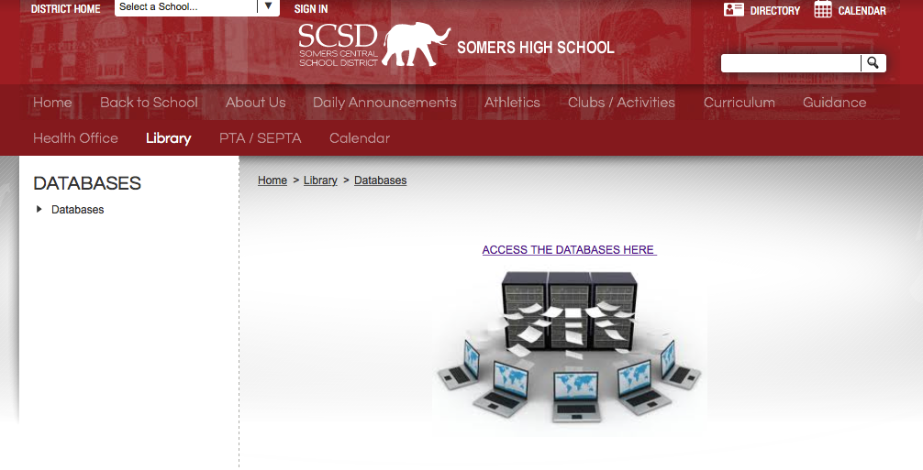
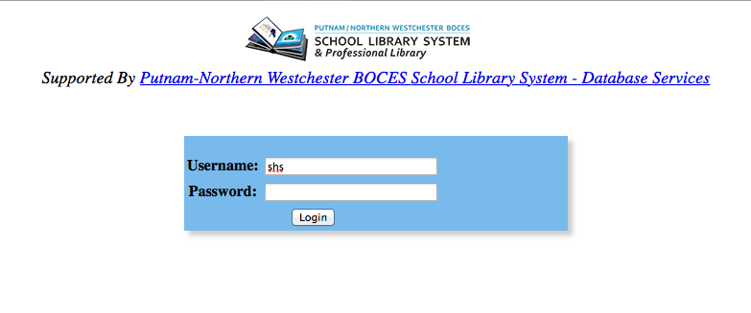
_________________
look
Notes:
ProQuest, OVID Medline

Slide 3
ScienceDirect
Produced by Elsevier, largest publisher of scientific journals in the world
full-text scientific database offering journal articles and book chapters from nearly 2,500 journals and 26,000 books
Offered by Elsevier to High Schools for Science Research students
Some full-text available: only on the Somers campus
http://www.sciencedirect.com

Slide 4
Public Library of Science
“nonprofit publisher and advocacy organization founded to accelerate progress in science and medicine by leading a transformation in research communication”
Core objectives:
Provide ways to overcome unnecessary barriers to immediate availability, access and use of research
Pursue a publishing strategy that optimizes the quality and integrity of the publication process
Develop innovative approaches to the assessment, organization and reuse of ideas and data
Increasing operational capacity to support the 34,000 articles published in 2013, a 33% increase over 2012:
http://www.plos.org

Slide 5
High Wire Press
Affiliated with Stanford University
A leading ePublishing platform
partners with independent scholarly publishers, societies, associations, and university presses digital dissemination of more than 3000 journals, books, reference works, and proceedings.
Over 7 million articles – 2 million free
http://home.highwire.org
http://highwire.stanford.edu/cgi/search (search platform)

Slide 6
What to remember:
Identify database parameters (what’s in it?)
Do advanced searches
Google Advanced Search
Set up alerts
Browse and use search pages of important journals in your area

Slide 7
www.linkedin.com/in/jamescassuto

Slide 8
Scenario 1:
“I kinda think I’m interested in cancer research…”
Narrow your search: choose a more specific area of interest
Try:
GoogleScholar search – limit the year
Science web sites and look at current events in “Cancer Research”
Look at what remains to be done
Google/Search engine search:
University web sites
Descriptions of current projects

Slide 9
General Science Sites
New Scientist | http://www.newscientist.com/
Science | http://www.sciencemag.org/
Science (Government Site) | http://www.science.gov
Science Daily | http://www.sciencedaily.com/
Science Master | http://www.sciencemaster.com/
Science News | http://www.sciencenews.org/
Science Times (NY Times) | http://www.nytimes.com/pages/science/index.html
Scientific American | http://www.sciam.com/
Scientific American Mind | http://www.scientificamerican.com/sciammind/
Seed | http://www.seedmagazine.com/news/
Smithsonian Institution | http://www.si.edu
Notes:
These are very typical of work you will be asked to do in college

Slide 10
Subject Specific Science Sites
Artificial Intelligence at MIT | http://www.ai.mit.edu/
Atmospheric Science Research | http://www.asrc.cestm.albany.edu/research1.htm
BMC Biochemistry | http://www.biomedcentral.com/bmcbiochem/
Chemweb | http://www.chemweb.com/databases
Cornell Ornithology Lab | http://www.birds.cornell.edu/page.aspx?pid=1662
Cyanova (e-magazine) | http://www.cyanova.com
Electrochemical Science and Technology | http://ecsdl.org
Florida A&M University Great Science Sites on the Web | http://library.famu.edu/scienceweb
Free Medical Journals | http://www.freemedicaljournals.com/
Frontiers in Bioscience | http://www.bioscience.org/
Institute of Physics | http://www.iop.org/
Mathematical Journals | http://www.ams.org/mathweb/mi-journals.html
National Institute of Health | http://www.nimh.nih.gov/
Nature | http://www.nature.com/
NASA | http://www.nasa.gov
Oak Ridge National Laboratory | https://www.ornl.gov/content/science-and-discovery
Physical Sciences Resources Center | http://www.psrc-online.org/
PubMed (Medical) | http://www.ncbi.nlm.nih.gov/entrez/query.fcgi

Slide 11
Scenario 2:
“My mom knows this great scientist who will be my mentor…”
How do I find out about her?
GoogleScholar search
University/Hospital/Research facility institutional site
Facebook LinkedIn
How do I know if I like her work?
Can you explain it to yourself so that you understand it?
Can you meet/talk to her and see if you click?
If the answer to either is “no,” or you think it seems boring, think carefully…..

Slide 12
Scenario 3:
“I found a good journal article but I have no idea how to make contact with the author…”
How do I locate him?
GoogleScholar search – scholar page??
University/Hospital/Research facility institutional site
Facebook
LinkedIn
Then what?
Email – direct or through an institutional connection
Phone
Google search

Slide 13
Scenario 4:
“I found a great article but it was published in 1977…”
GoogleScholar search
Look at Citing Articles
Search within Citing Articles

Slide 14
Scenario 5:
“I found a great citation – article looks really good – but I can’t find the full text anyplace….”

Slide 15
Scenario 5:
“I found a great citation – article looks really good – but I can’t find the full text anyplace….”
Email the author directly & see if s/he will just give you a copy
University ILL …………….. Wait….

Slide 16
Sources of Peer-reviewed Journal Articles
School Databases – SHS Library Web Page
ProQuest (Password: look)
OVID Medline
OVID PsychInfo
MUSE
School Databases – Elsewhere
ScienceDirect
Web-Based Sources
Science Web Sites – good for introductory information
Google Scholar
Public Library of Science
HighWire
Notes:
These are very typical of work you will be asked to do in college

